Slide 1
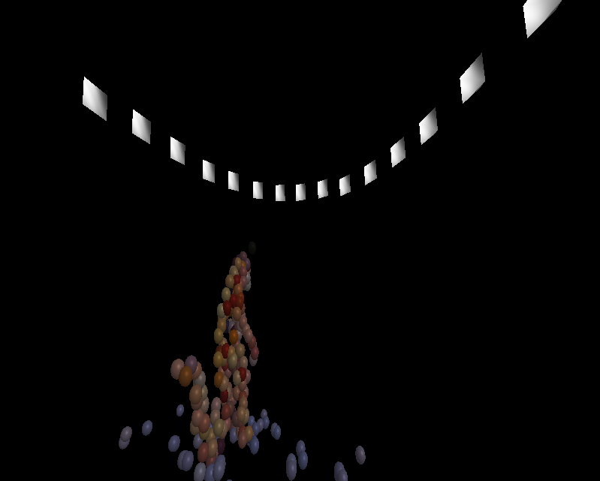
TSBB15 3D Reconstruction Group 2 “Epipolarna”

Slide 2
Modules
2D correspondence extraction – Alexander
Main program and pipeline – Mattias
Non-linear optimization – Martin
Visualization – Gustav

Slide 3
The 3D Reconstruction pipeline
Noisy, lots of false positives.
False positives are mostly isolated.
Easy to handle with later processing steps.

Slide 4
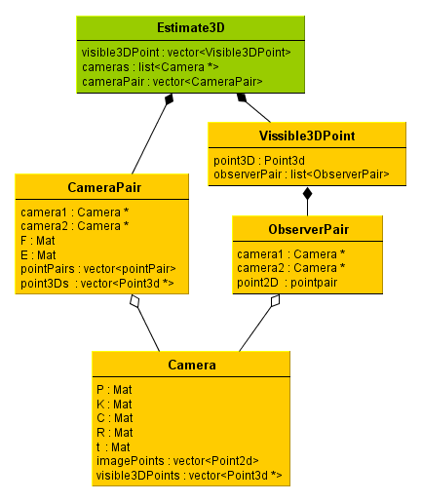
Data Structures
Data structure for cameras.
Links original 2D points to 3D points.
Links camera to visible points.

Slide 5
File output
Output each step of the reconstruction to a file.
Can be read by the visualizer for debugging/demonstration
Or resume reconstruction from the saved point.

Slide 6
Main program

Slide 7
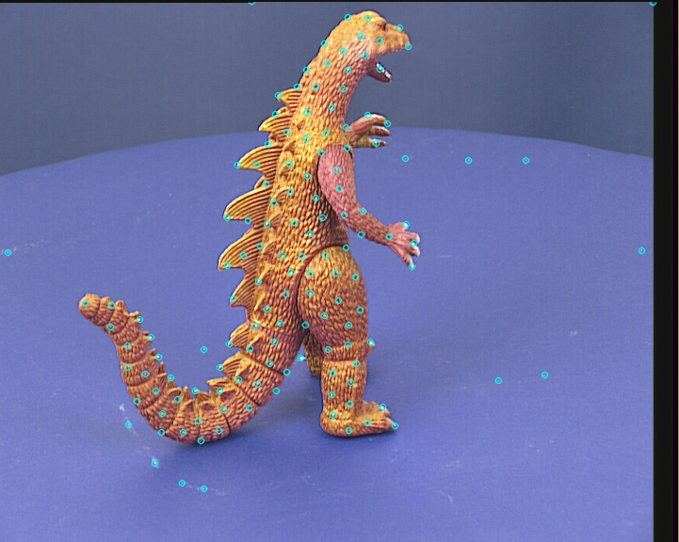
2D point extraction
Extract interesting points from images.

Slide 8
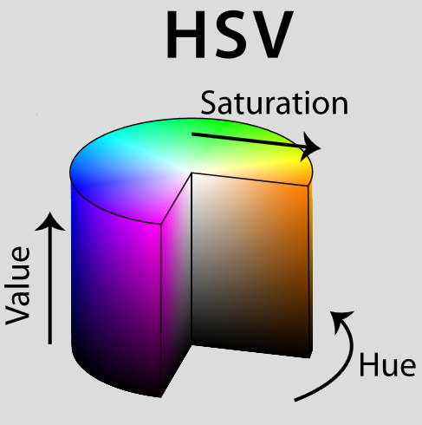
Estimation of F
Algorithm implemented as described in the master thesis by John Wood.
HSV mapping:
Easy to implement
Good performance
Few false positives
Problems with gray areas

Slide 9
Estimation of R and t
“Distance filtering”
Throw away foreground regions not thick enough
Good performance
Slow?
Implementation
cv::findContours, cv::pointPolygonTest
Iterate over bounding rectangle
Measure distance inside contour only
Final touch: some morphological dilate

Slide 10
Solving the PnP
Object creation
Find remaining contours
Create bounding boxes
Calculate positions

Slide 11
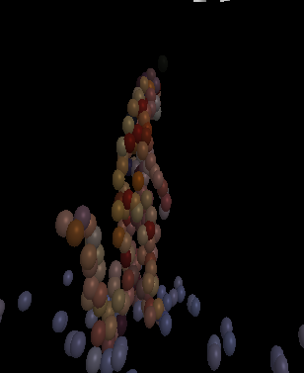
Visualization
Plot the estimated cameras
Plot the 3D points
Points colored from original image data.

Slide 12
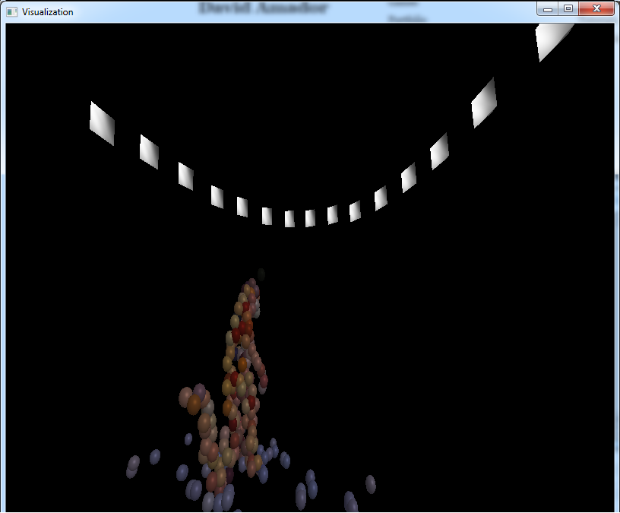
Evaluation
Slow, especially bundle adjustment.
Very good results tough.
Still brutal divergence if to many outliers.

Slide 13
Results
Very slow for many cameras.
But it works.
It is awsome.

